Slide 1
Longer Term
Aerosol Chemical speciation monitoring data during ACTRIS/EMEP activities
ACSM Teams across Europe
Many slides from Michael Bressi, JRC Italy

Slide 2
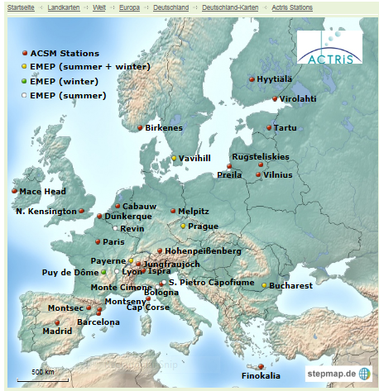
ACSM stations
Half hourly measurements of submicron organic mass, sulfate, nitrate, ammonium during at least a season, ideally for full years
Organic mass spectra can be used to derive sources and components of organic aerosols (traffic, biomass burning, coal burning, cooking, secondary organic aerosols)
Sampling sites
+ 20 potential sites in 12 different countries
+Site types: 2 remote/ high altitude, 2 urban background, 6 coastal, 10 rural background sites
Heterogeneity of sampling site locations, types, altitude, etc.
?
2
http://www.psi.ch/acsm-stations/acsm-station

Slide 3
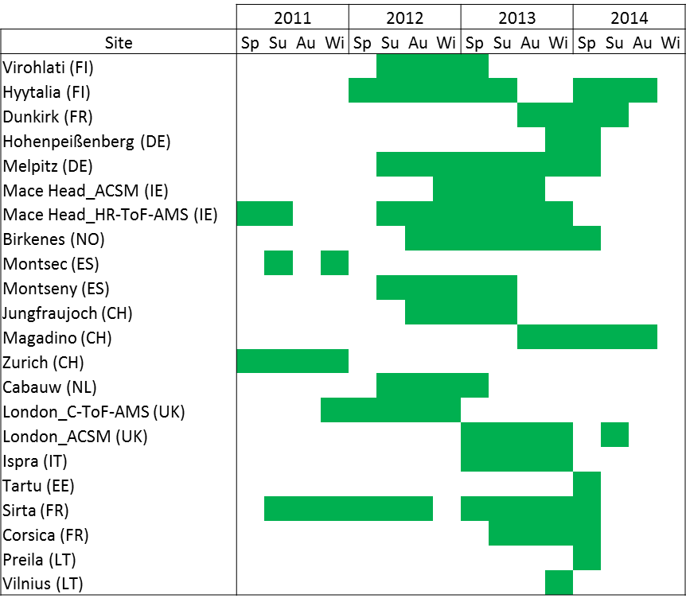
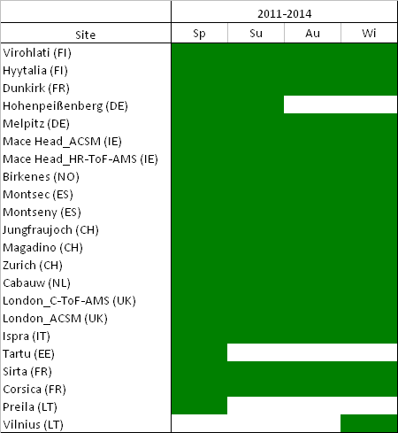
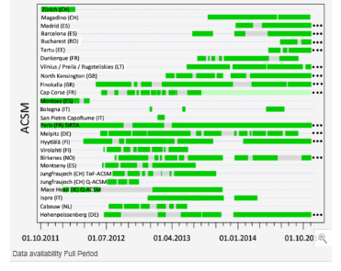
MATERIAL AND METHODS
Data coverage
From 1 Feb. 2011 to 2015
1
2
http://www.psi.ch/acsm-stations/overview-full-period
Assumptions:
1
If data coverage> 1.5 months in a given season → data representative of the full season (Spring=MAM, Summer=JJA, etc.)
3

Slide 4
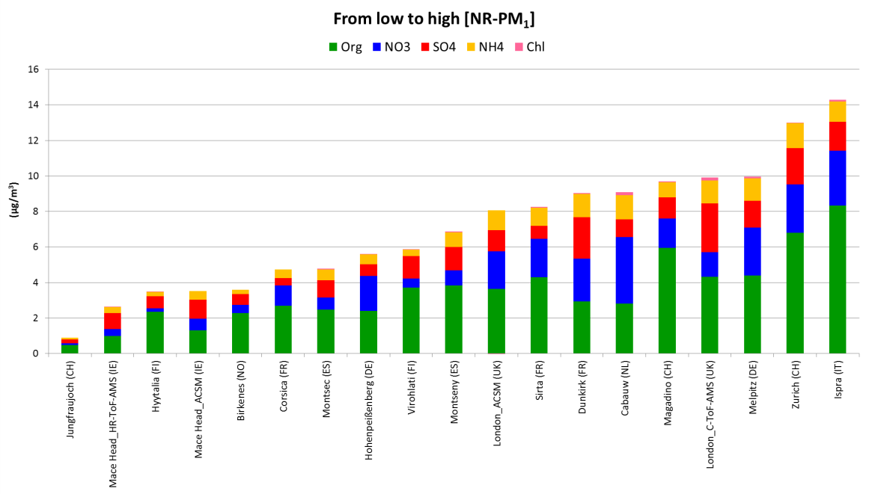
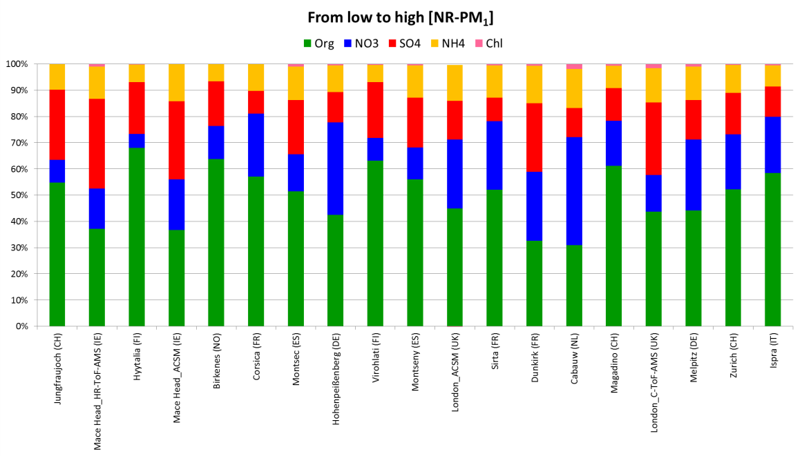
PRELIMINARY RESULTS
Chemical composition of NR-PM₁
+ Organics are the main component of NR-PM₁ (min 31%, max 62%, median 52%)
4

Slide 5
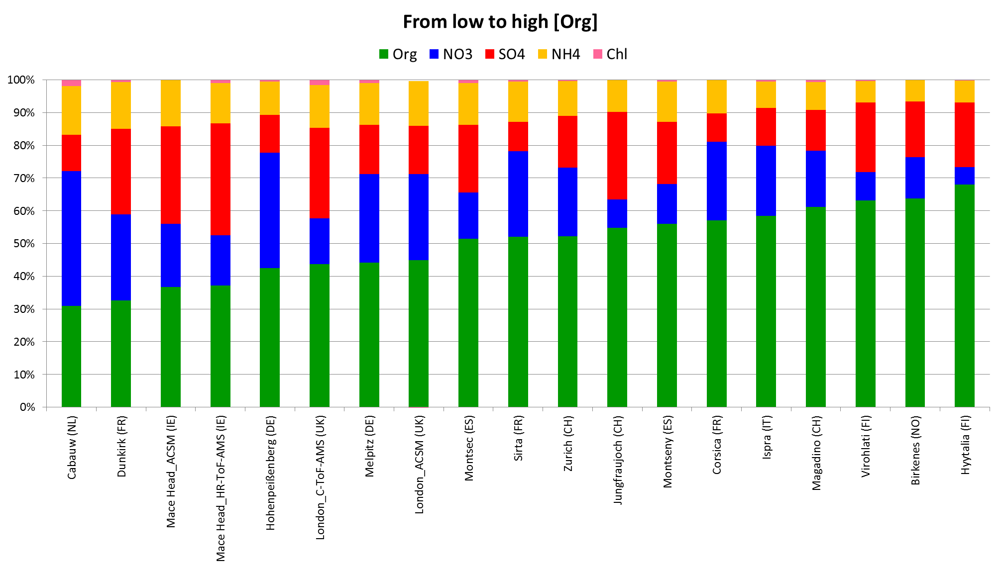
Chemical composition of NR-PM₁
+ Large variety of sources and processes leading to the formation of organics → no clear trend
+ Nevertheless: highest [Org] relative contribution in Nordic countries (FI, NO)

Slide 6
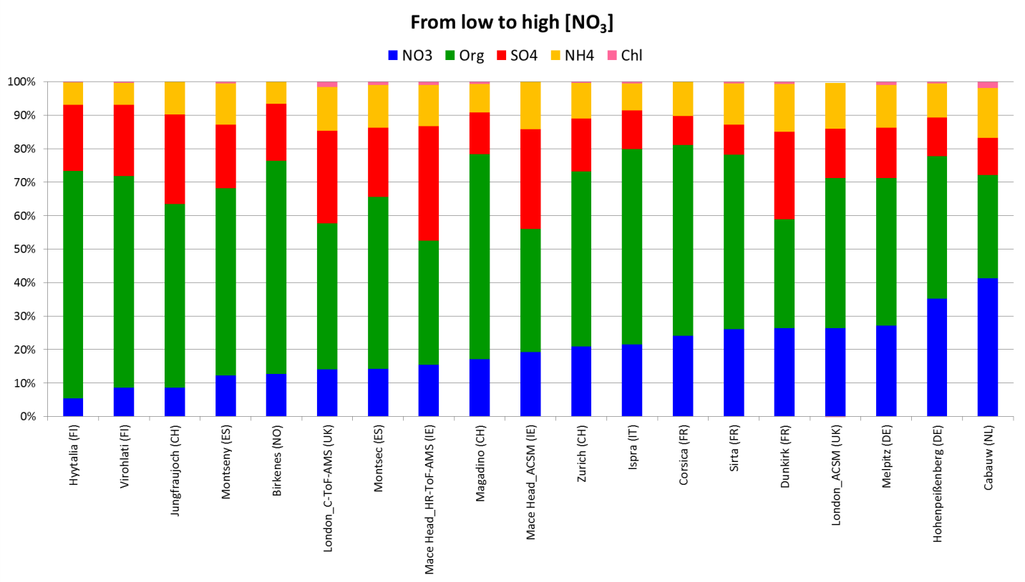
Chemical composition of NR-PM₁
*
*
+ Nordic countries (FI, NO) → among the lowest NO₃ contributions (typically <10% of NR-PM₁)
+ Mid-latitude Europe → among the highest NO₃ contributions (typically >20% of NR-PM₁)

Slide 7
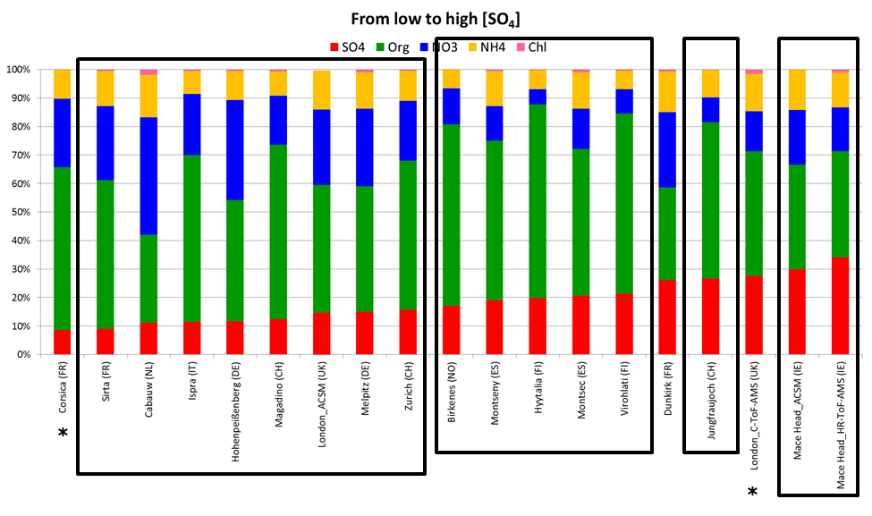
Chemical composition of NR-PM₁
+ Highest SO₄ contributions (>15%) for lowest NR-PM₁ levels (<7 µg/m³)
+ Lowest SO₄ contributions in mid-latitude Europe
7

Slide 8
Composition overview paper led by M. Bressi, JRC
GOALS
Analysis of relative composition per season
Daily cycles of the various components in different seasons
Analysis of relative composition as a function of concentration or other parameters
Current goal: submission of paper in January 2016. Data will then become completely available

Slide 9
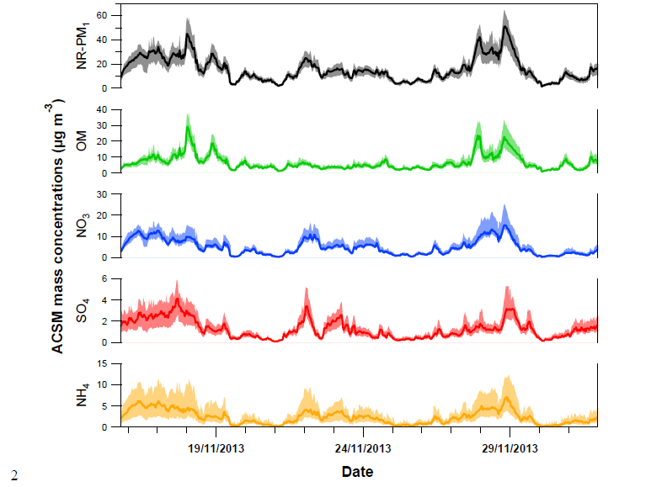
INTERCOMPARISON EXERCISE within ACTRIS
Comparison of 13 ACSMs near PARIS
Will be submitted by Crenn et al. this week to AMT

Slide 10
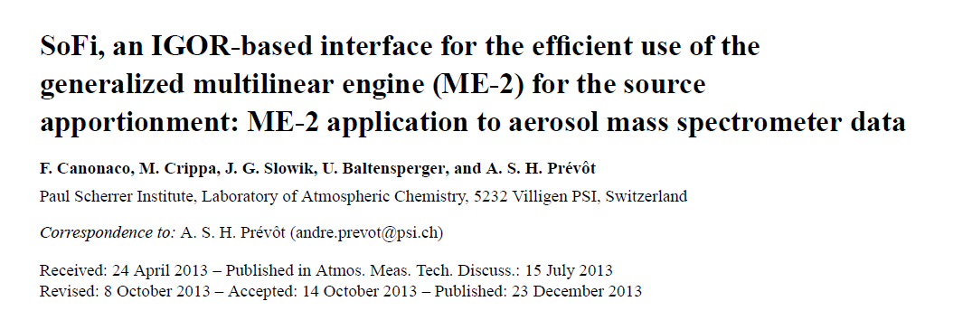
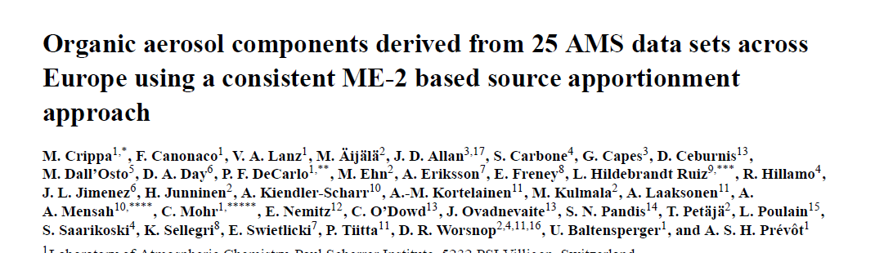
Source apportionment
AMT, 2013
ACP, 2014

Slide 11
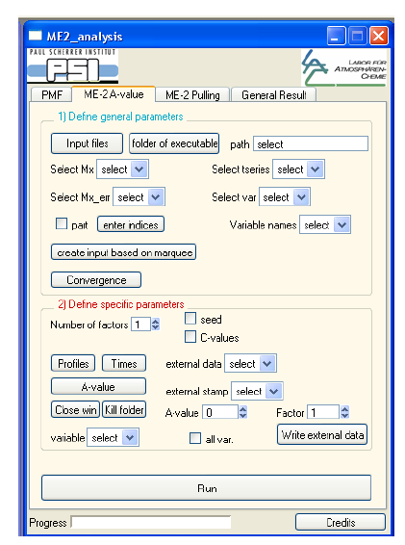
SoFi as an efficient evaluation tool gets widely spread
This year we had two workshops with a total of around 60 people from all around the world, mostly Europe and ACTRIS related

Slide 12
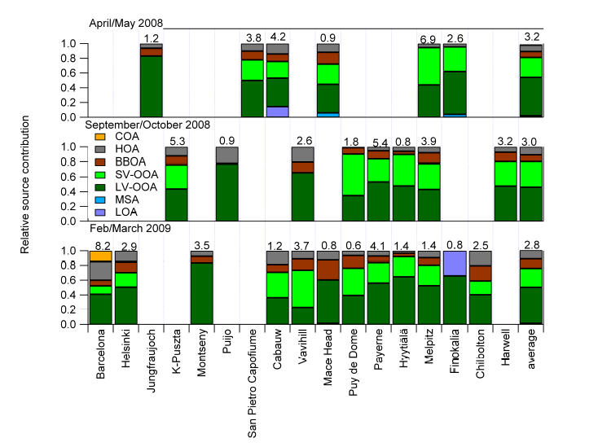
Overview of relative organic aerosol sources (1 month data)
Crippa et al.,, ACP, 2014

Slide 13
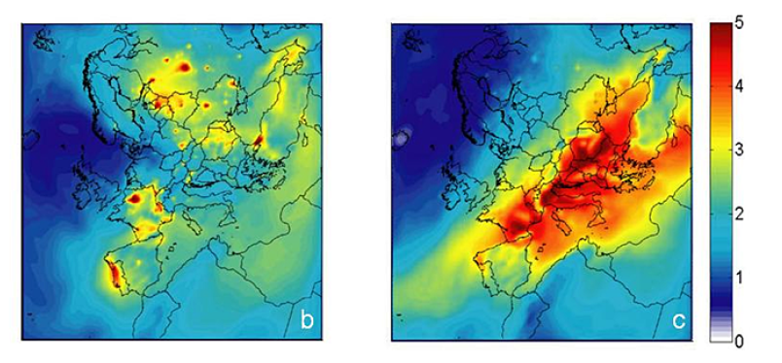
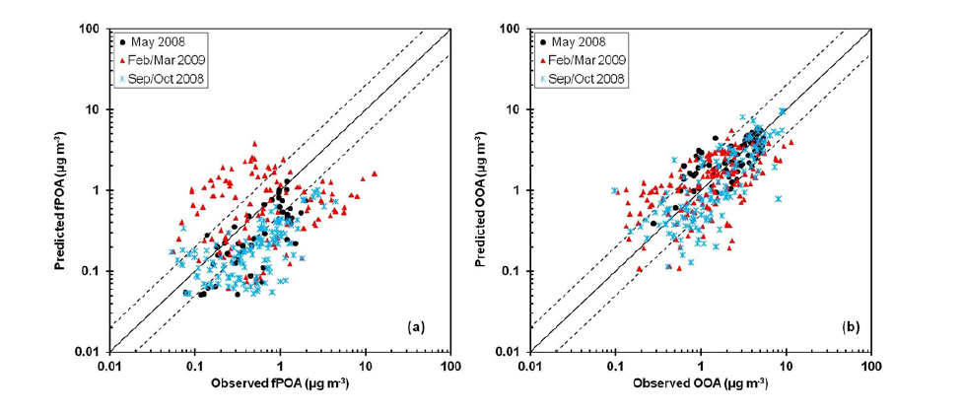
First model evaluations for organic aerosols
Feb/March 2009
September/October 2008
VBS type models clearly more successful to model organic aerosols
Most models in EURODELTA underestimate organics, especially SOA
Fountoukis et al., ACP, 2014

Slide 14
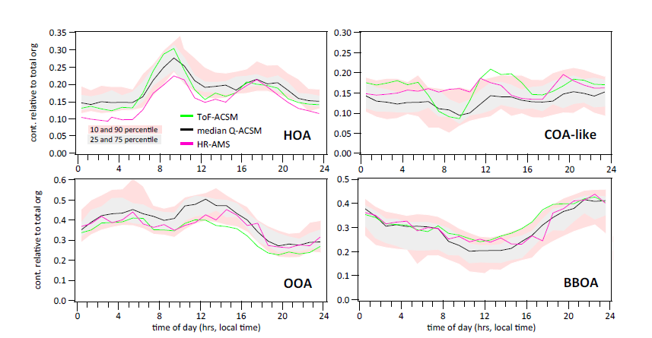
Comparison exercise near Paris
Froehlich et al., AMTD, 2015

Slide 15
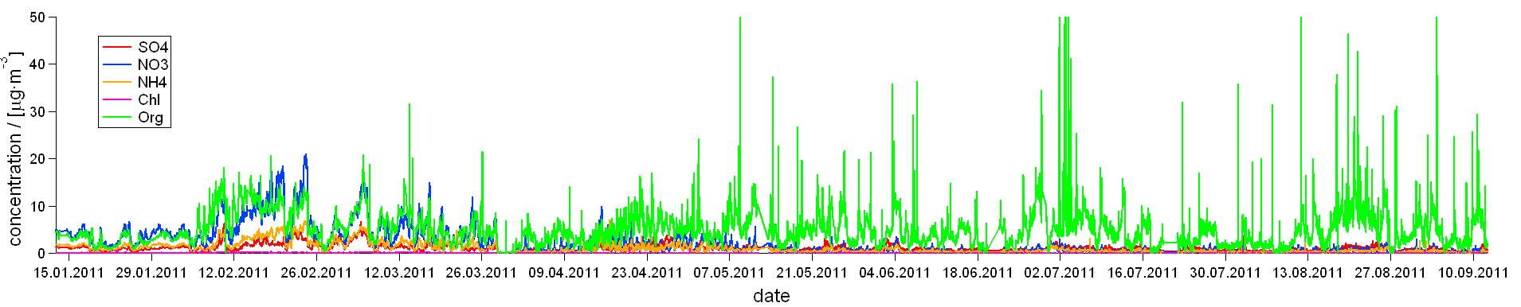
FULL YEAR datasets
Methods to analyze a full year is still under development.
AURO-SoFi (Automatic rolling source finding)
Perform source apportionment with ME-2 over 1-2 months periods and roll this window with a step of e.g. one day around the year or around daily temperature sorted data. PMF/ME-2 over the whole year clearly have limitations because different SOAs do not unmix easily.
One performs for each time window around 100 ME-2 runs with different constraints (e.g. fixing a traffic organic aerosol factor at different degrees) and chooses the best solutions according to chosen criteria (e.g. cooking peak at noon, correlations of traffic organics with NOx)
One keeps several results for the same day which allows to assess the uncertainty.

Slide 16
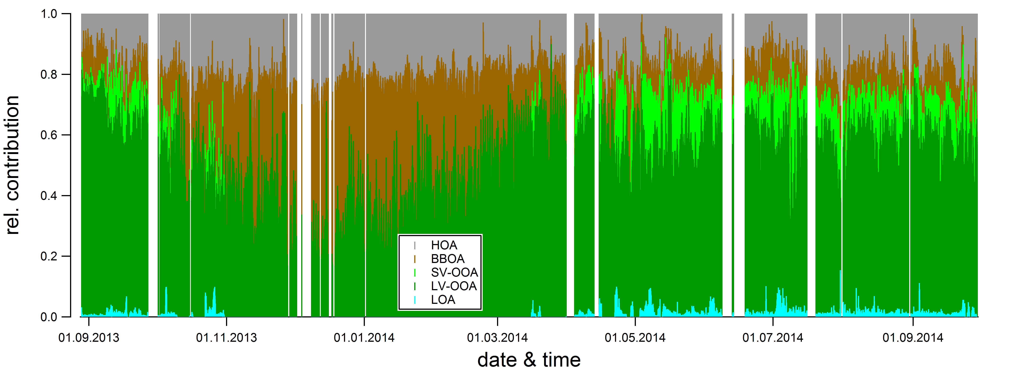
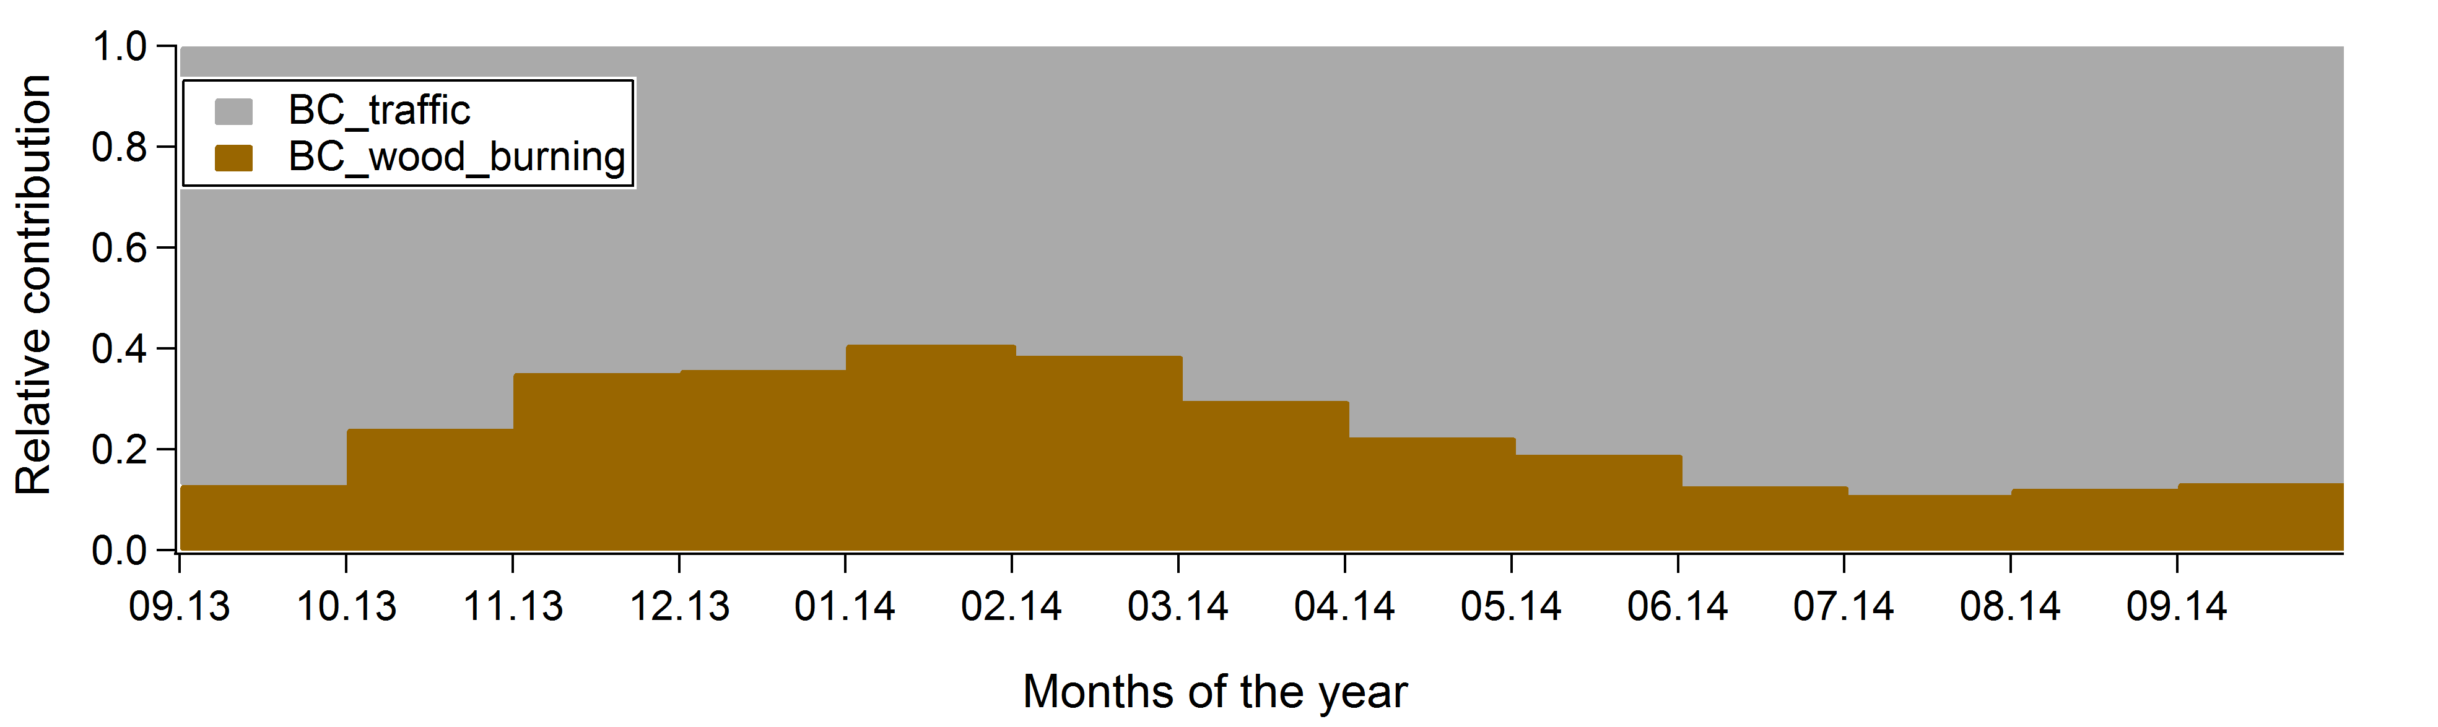
Yearly cycle of OA and BC sources (Aethalometer) in Magadino
Modelled HOA and BBOA factors were constrained using “reference” profiles obtained from PMF analysis of the winter Magadino data, within a-value range [0, 0.5]
Local factor was constrained using a LOA profile form PMF run on the summer data, a-value range [0, 0.5]

Slide 17
FUTURE
FIRST OVERVIEW SOURCE APPORTIONMENT PAPER: submission mid-2016 to end 2016 (optimistic)
Another phase of EURODELTA or similar model evaluation exercises. Important: Opportunity for development and assessment of Volatility Basis Set or other modern schemes for organic aerosols
Also more coordinated future measurements within ACTRIS 2 and hopefully COST action
Combination with equivalent black carbon measurements would be very useful (ideally multi-wavelength to distinguish traffic from wood burning)

Slide 18
IDEAL FUTURE CAMPAIGN
COMBINATION OF THE ACSM data sets with off-line analyses of organic markers, off-line AMS and other methods over full years. This could also be done for twin sites (rural/urban)

Slide 19
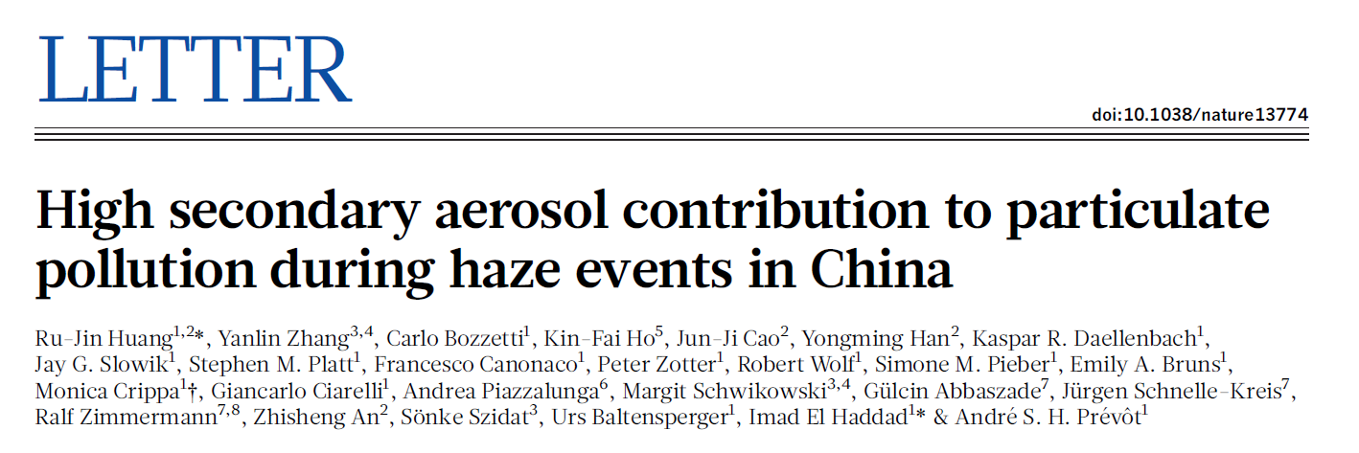
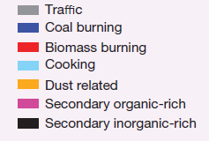
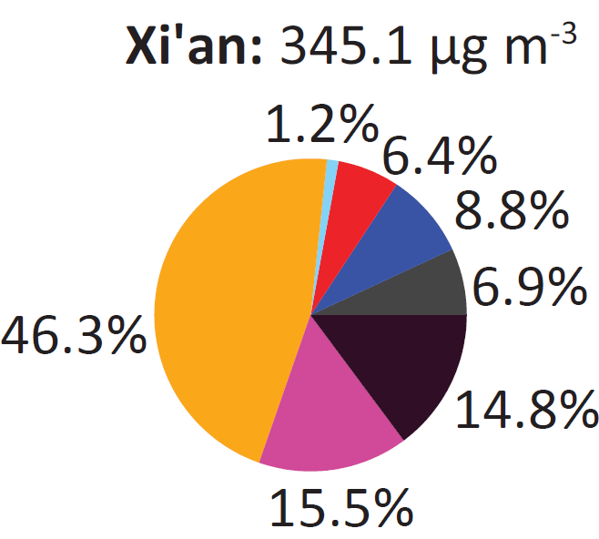
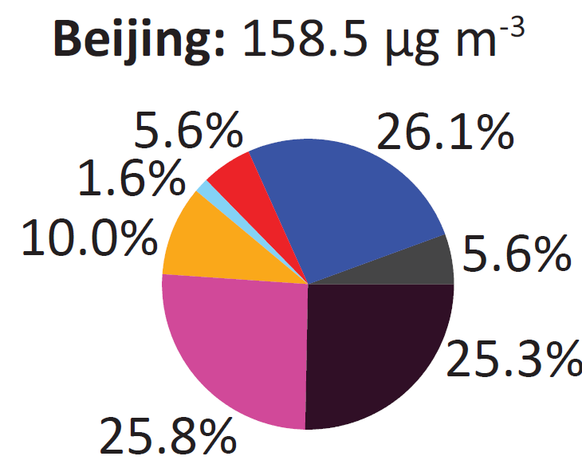
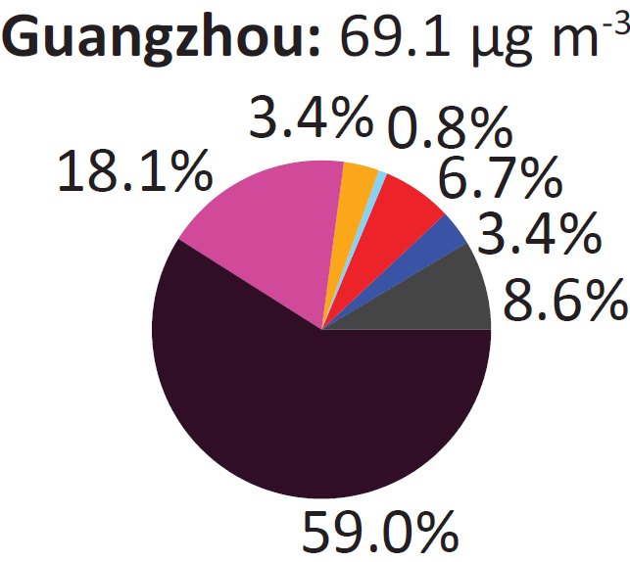
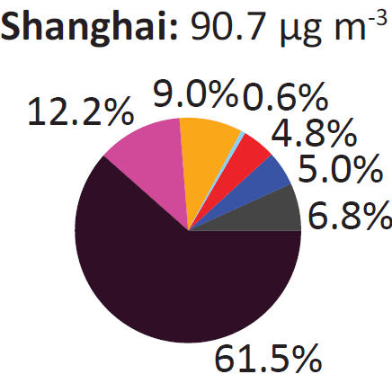
Combination of new and classic off-line methods
Sources of PM_{2.5}
North
South
Contribution of primary anthropogenic sources is relatively low, dominated by the residential emissions from heating and cooking processes

Slide 20


Winter haze in Switzerland
Source apportionment
- Daellenbach et al., in prep b
Similar situation to china without coal emissions
Residential primary emissions from biomass burning prevails over traffic
Biomass burning levels in the South (11 μg m⁻³) are 2x higher compared to the North (5 μg m⁻³), because of the use of less efficient stoves
SOA is a very important fraction, especially in the north
24

Slide 21
Situation in Europe
Zurich
Milano

Slide 22
Situation in Europe
Long range transported Summer SOA
Dallenbach et al., in prep
Zurich
9

Slide 23
IDEAL FUTURE CAMPAIGN to address organics
COMBINATION OF THE ACSM data sets with off-line analyses of organic markers, off-line AMS and other methods over full years to cover much more of Europe. This could also be done for twin sites (rural/urban).
Necessary funding per station (100 Hi-Vol filters across the year): around 20’000-30’000 Euros per station and year
To be considered in any case: Freeze Hi-Vol-Filters over longer term for future analyses.

